Slide 1
Tragic Love
An Introduction to Romeo and Juliet

Slide 2
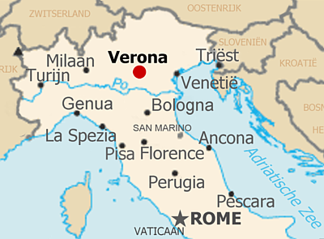
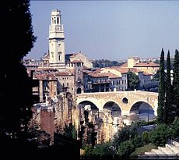
Romeo and Juliet Setting
Verona, Italy
Late 1500s

Slide 3
Characters: The Capulets
Juliet Capulet
Lord and Lady Capulet
Count Paris
Tybalt
Nurse

Slide 4
Characters: The Montagues
Romeo Montague
Lord and Lady Montague
Benvolio Montague
Mercutio
Friar Laurence

Slide 5
Part I: Summary
A family feud
Falling in love
A secret marriage

Slide 6
Summary
A fight
A banishment
A match-making father

Slide 7
Summary
A desperate plan
Some deadly gossip
The death of Romeo and Juliet
A lesson learned

Slide 8
Romeo and Juliet Today
Why do we read Romeo and Juliet today?
How does the story connect to the lives of teenagers today?

Slide 9
Part II: Tragedy
Romeo and Juliet is a tragedy.

Slide 10
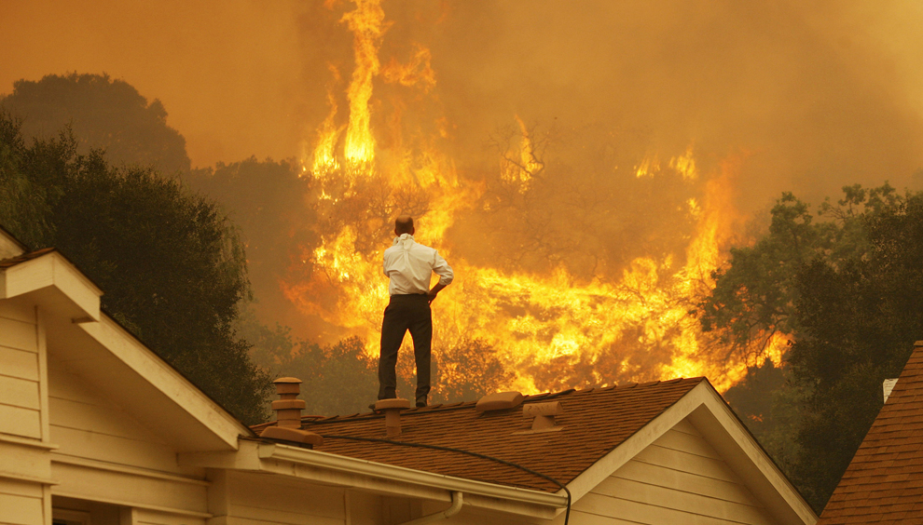
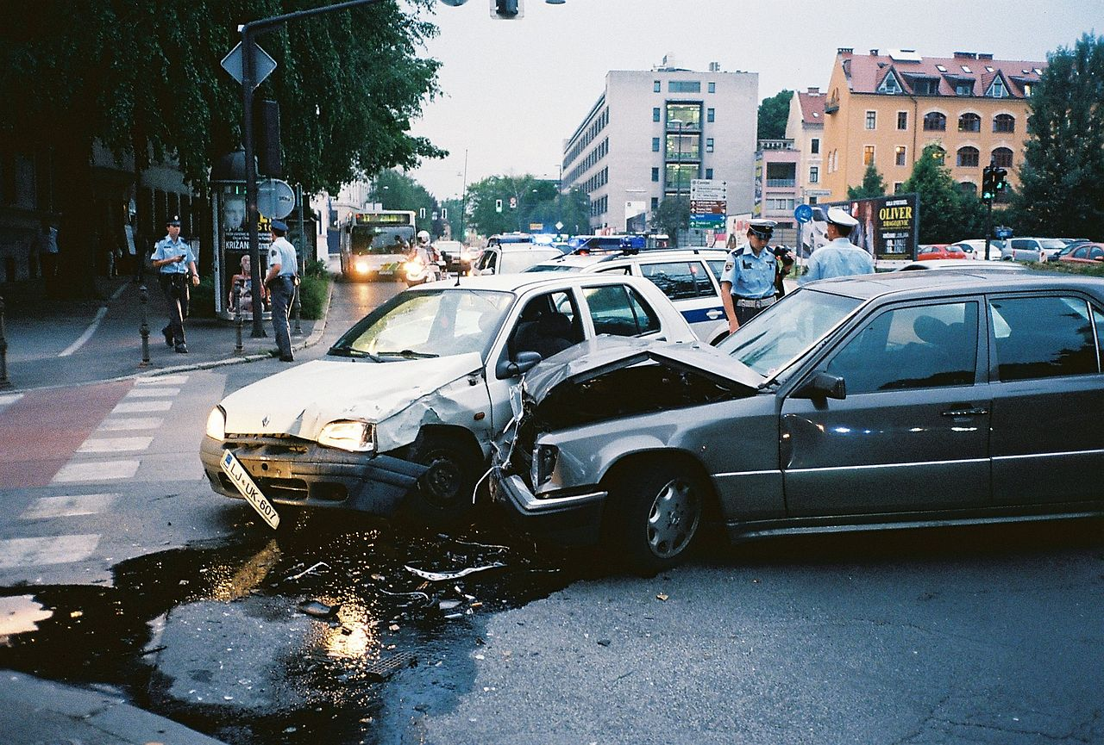
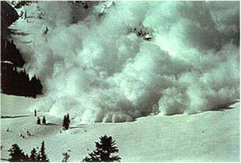
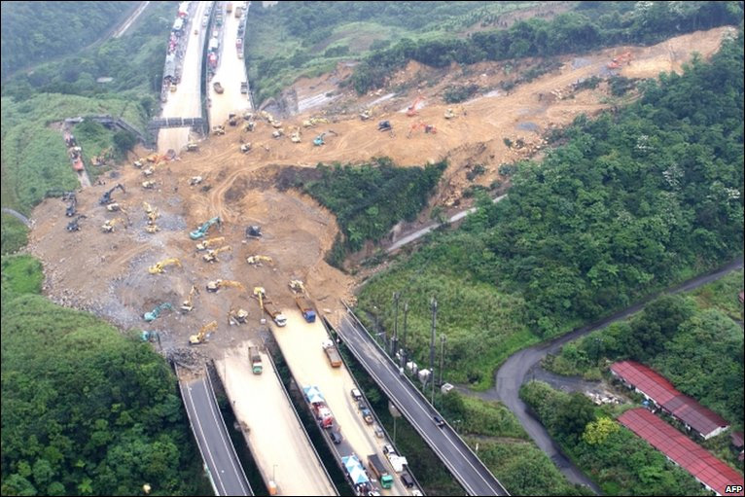
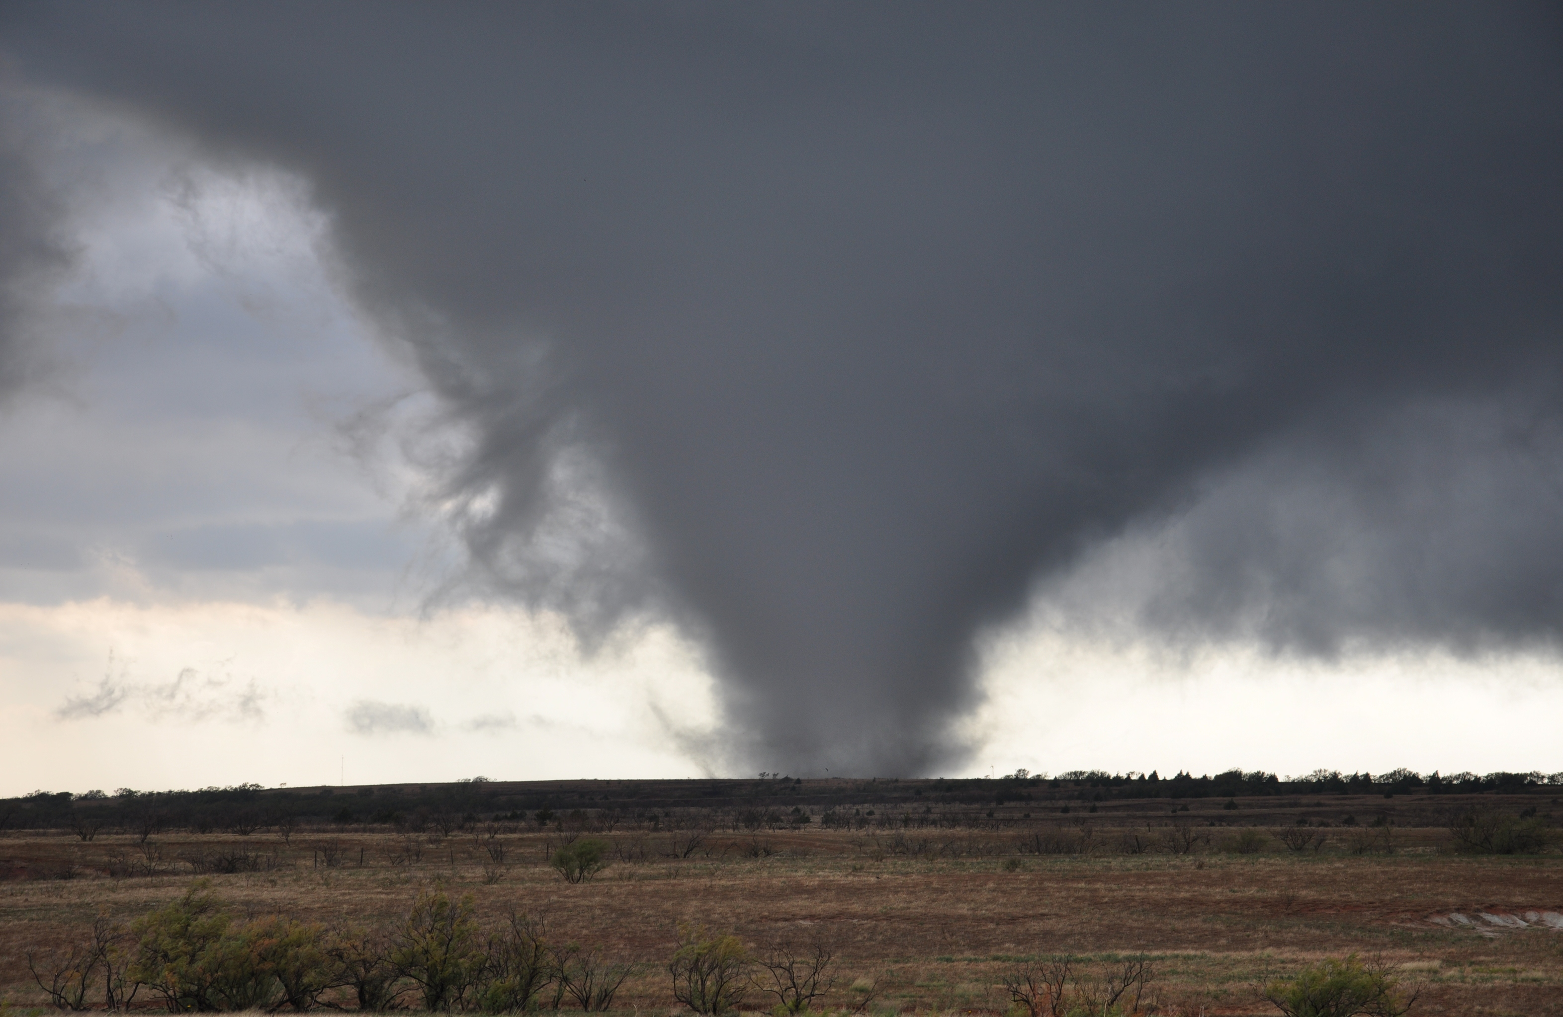
Examples of Tragedy

Slide 11
Thinking about Tragedy
What T.V. shows, movies, or books show tragedy?
How does tragedy affect people’s lives?

Slide 12
Tragic Love?
Romeo and Juliet is considered a “tragic love story.”
What is tragic love?
How does tragic love affect teenagers today?

Slide 13
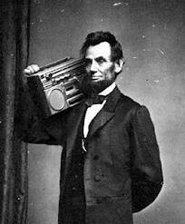
Anachronisms
An anachronism is an object or idea that is out of its time element.
Example:
Recliner, matches, electricity, etc.

Slide 14
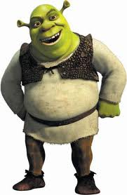
Character
A person portrayed in a literary work
Main Character (Shrek)– central to the story; fully developed
Minor Character (Donkey) – has few personality traits; helps move the story
Round Characters (Fiona)– show varied and sometimes contradictory traits
Flat Characters (Soldiers) – only show one personality trait
Dynamic Characters (Shrek)– grow and change throughout the story
Static Characters (Pinocchio)– stay the same

Slide 15
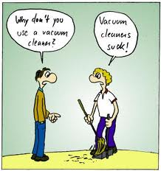
Pun - A play on words that have similar sounds but different meanings.
Examples:
Did you hear about the guy whose whole left side was cut off? He's all right now.

Slide 16
Irony - In literary criticism, the effect of language in which the intended meaning is the opposite of what is stated.
The title of Jonathan Swift's "A Modest Proposal" is ironic because what Swift proposes in this essay is cannibalism — hardly "modest."
A fish that drowns

Slide 17
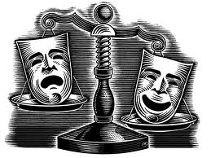
Drama
Works of literature meant to be performed on stage or read as a performance

Slide 18
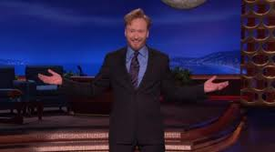
Monologue
A long speech in which a character speaks his/her thoughts aloud, addressing another character or the audience

Slide 19
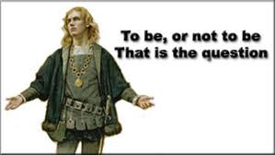
Soliloquy: a Dramatic Convention
A long speech addressed to no one in particular

Slide 20
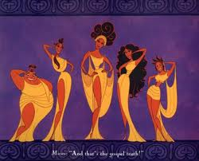
Chorus
Group of players who give key information about what’s happening

Slide 21
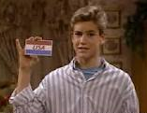
Aside
Private words that a character in a play speaks to the audience or to another character and that are not supposed to be overheard by others onstage.

Slide 22
Blank Verse
Poetry written in unrhymed iambic pentameter
“blank” = unrhymed
“iamb” = unstressed, stressed syllables
“penta” = five
“meter” = contains two syllables

Slide 23
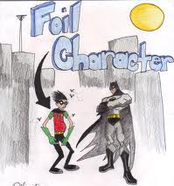
Foil
A character who sets off another character by strong contrast

Slide 24
Tragedy
A play, novel, or other narrative depicting serious and important events, in which the main character comes to an unhappy end

